Slide 1
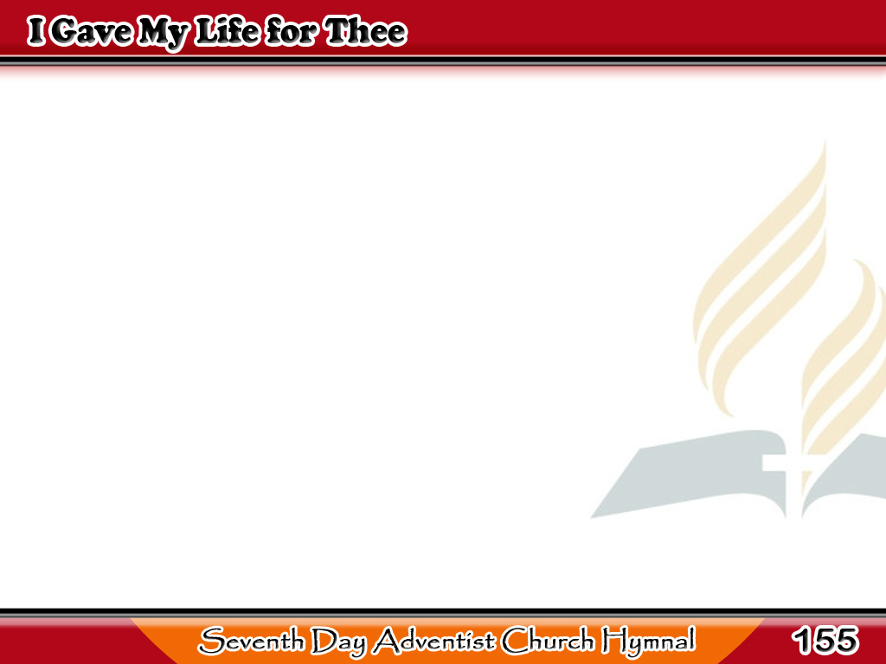
Buhay Ko’y Nabigay
I gave My Life to thee,
My precious blood I shed,
That thou might’st ransomed be,
And quickened from the dead;
1/3

Slide 2
Buhay Ko’y Nabigay
I gave, I gave My life for thee,
What hast thou given for Me?
I gave, I gave My life for thee,
What hast thou given for Me?
1/3

Slide 3
Buhay Ko’y Nabigay
My Father’s house of light,
My glory circled throne,
I left for earthly night,
For wanderings sad and lone;
2/3

Slide 4
Buhay Ko’y Nabigay
I left, I left it all for thee,
Hast thou left aught for Me?
I left, I left it all for thee,
Hast thou left aught for Me?
2/3

Slide 5
Buhay Ko’y Nabigay
I suffered much for thee,
More than thy tongue can tell,
Of bitterest agony,
To rescue thee from hell;
3/3

Slide 6
Buhay Ko’y Nabigay
I’ve borne,
I’ve borne it all for thee,
What hast thou
borne for Me? (2X)
3/3

